Slide 1
WSiZ „Copernicus” we Wrocławiu Architektura Komputerowa
„PUF na bazie Microblaze”
INF / Niestacjonarne
Grupa A / Grupa X
Student Volodymyr Gorbachov
Indeks: 6602

Slide 2
What is PUF?
A physical unclonable function – PUF (sometimes also called physically unclonable function, which refers to a weaker security metric), or PUF, is a physical object that for a given input and conditions (challenge), provides a physically-defined "digital fingerprint" output (response) that serves as a unique identifier, most often for a semiconductor device such as a microprocessor. PUFs are most often based on unique physical variations which occur naturally during semiconductor manufacturing. A PUF is a physical entity embodied in a physical structure. Today, PUFs are usually implemented in integrated circuits and are typically used in applications with high security requirements, more specifically cryptography.

Slide 3
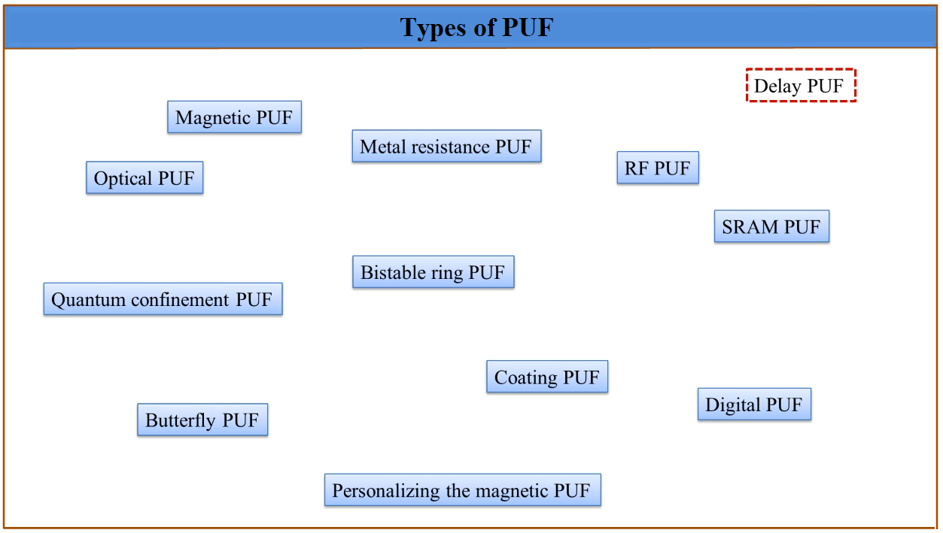

Slide 4
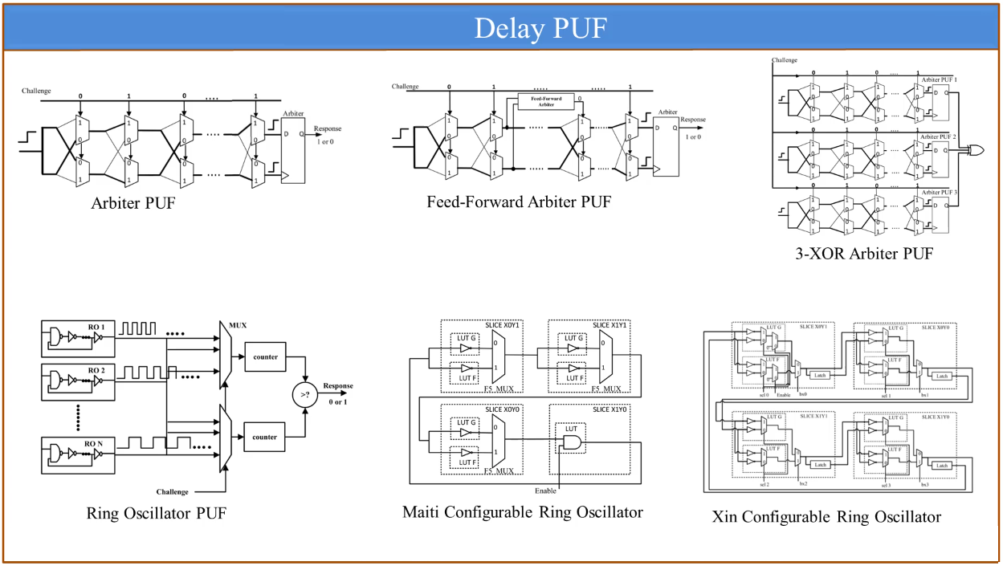
There are a lot of types of PUF that works by delay principle. The are two most common types of Delay PUF: Arbiter and Ring Oscillator. The simpliest one is Arbiter PUF. It consists of group of multiplexers.

Slide 5
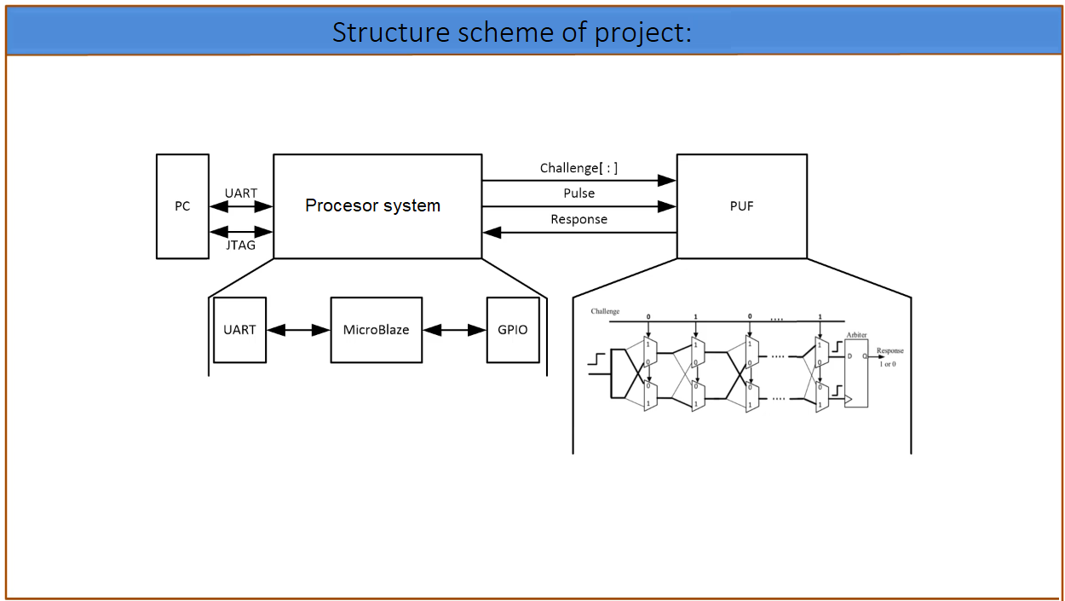

Slide 6
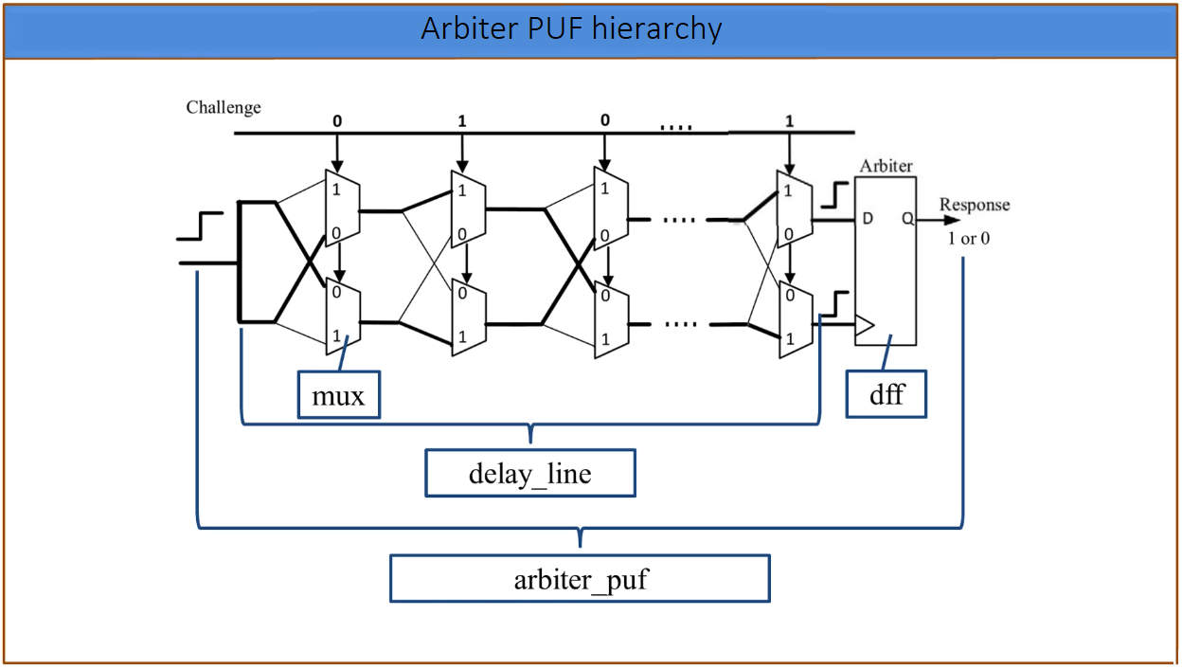

Slide 7

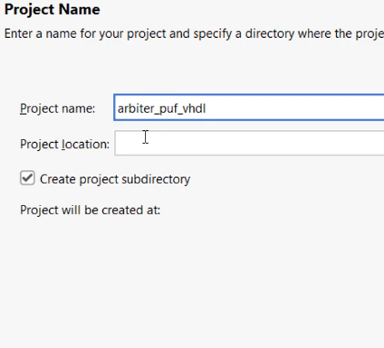
Step-by-step creation of Arbiter PUF:

Slide 8
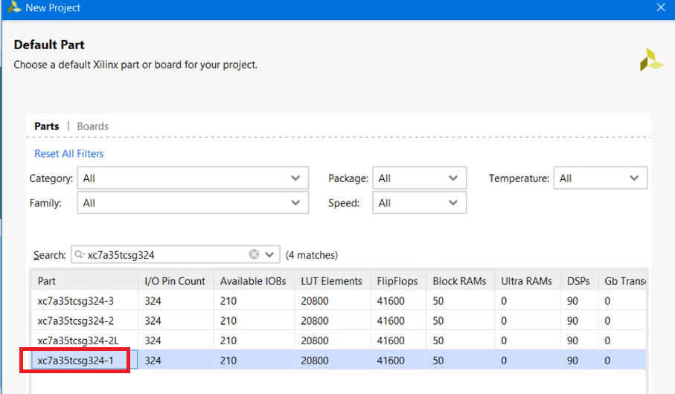
Crystal to be used is „xc7a35tcsg324-1”

Slide 9
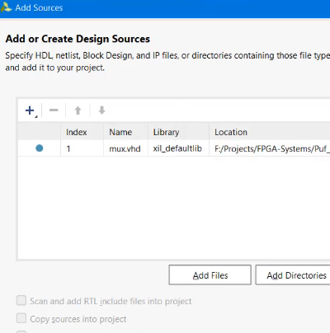
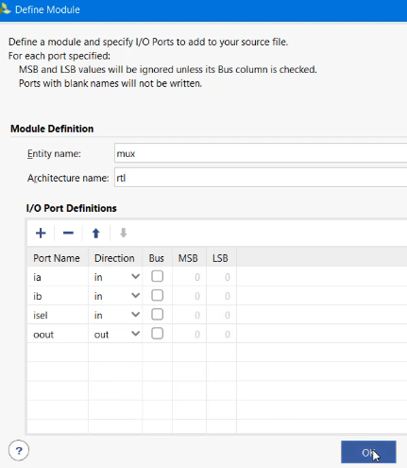
Adding module mux and ports {ia, ib, isel} - in, {oout} - out

Slide 10
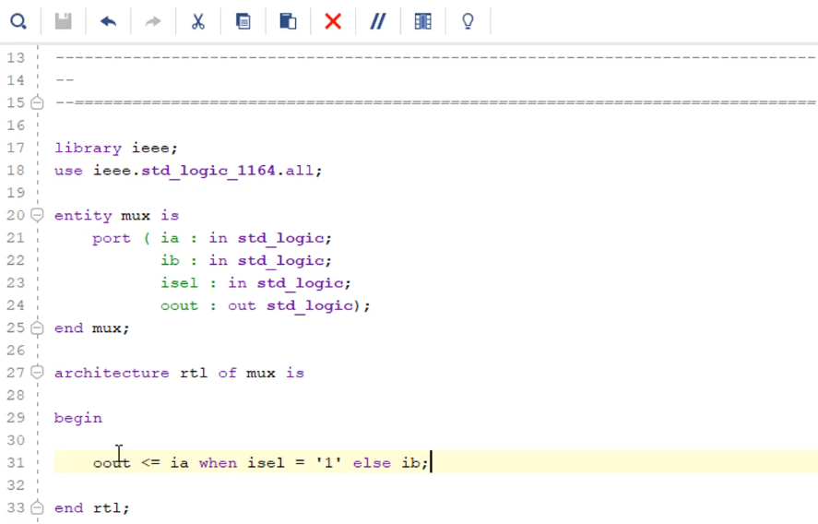
.vhd code for multiplexer:

Slide 11
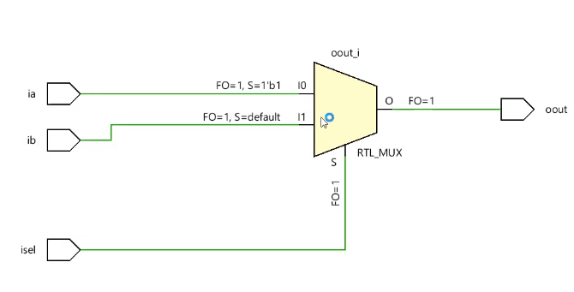
Open Elaborated Design show us a structure we created:

Slide 12
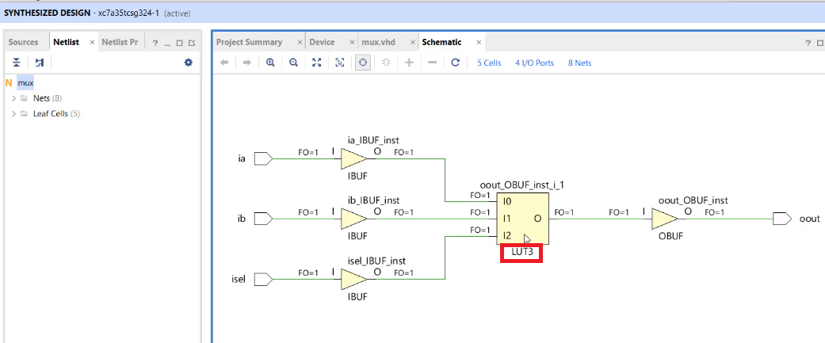
Run Synthesis shows us that multplexer is done on LUT:

Slide 13
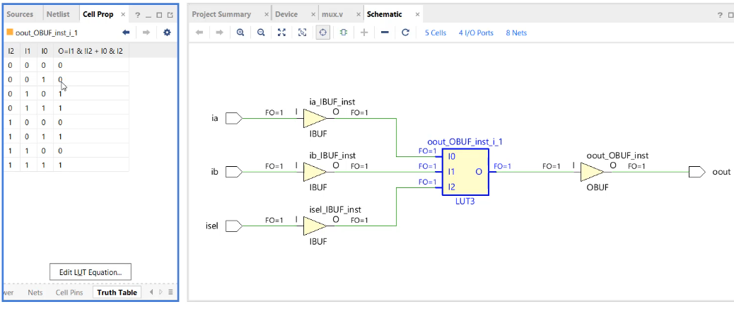
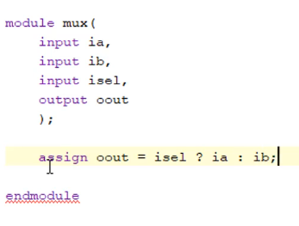
Verilog (.v) code for multiplexer and Schematic with Truth Table.

Slide 14
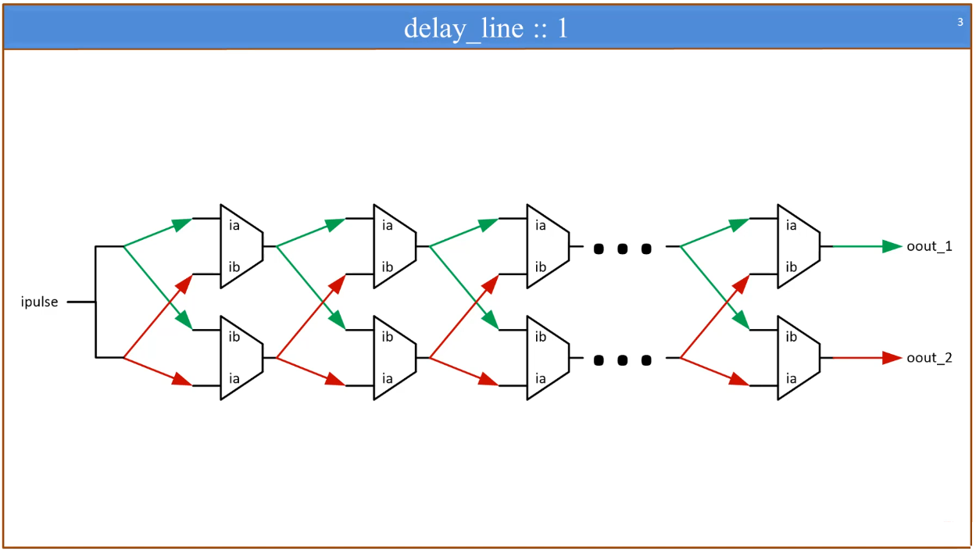

Slide 15
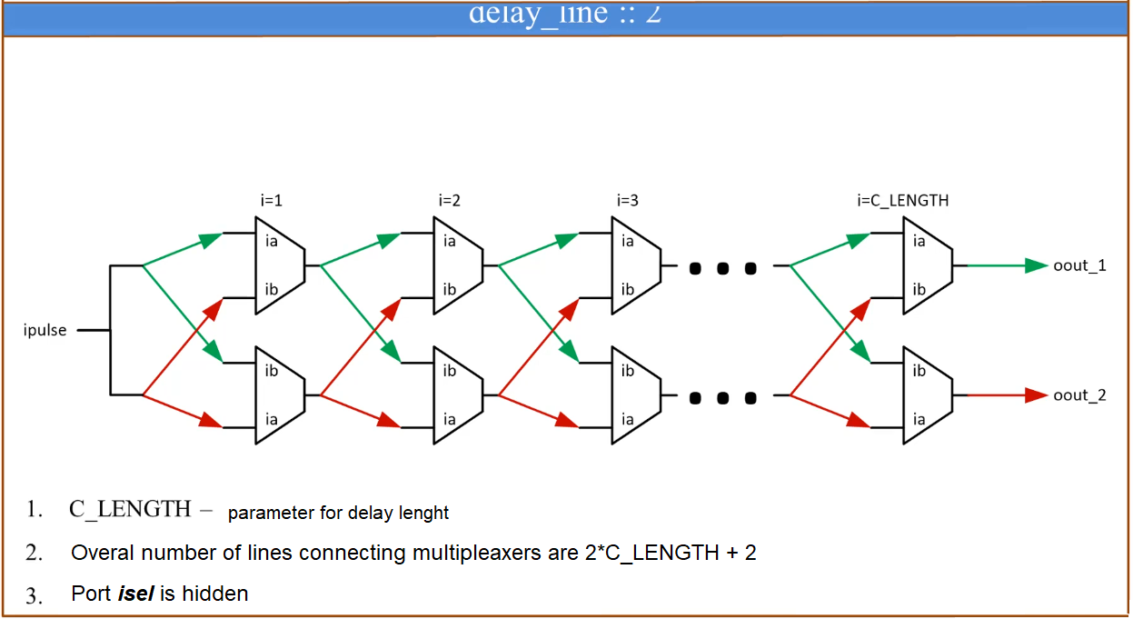

Slide 16
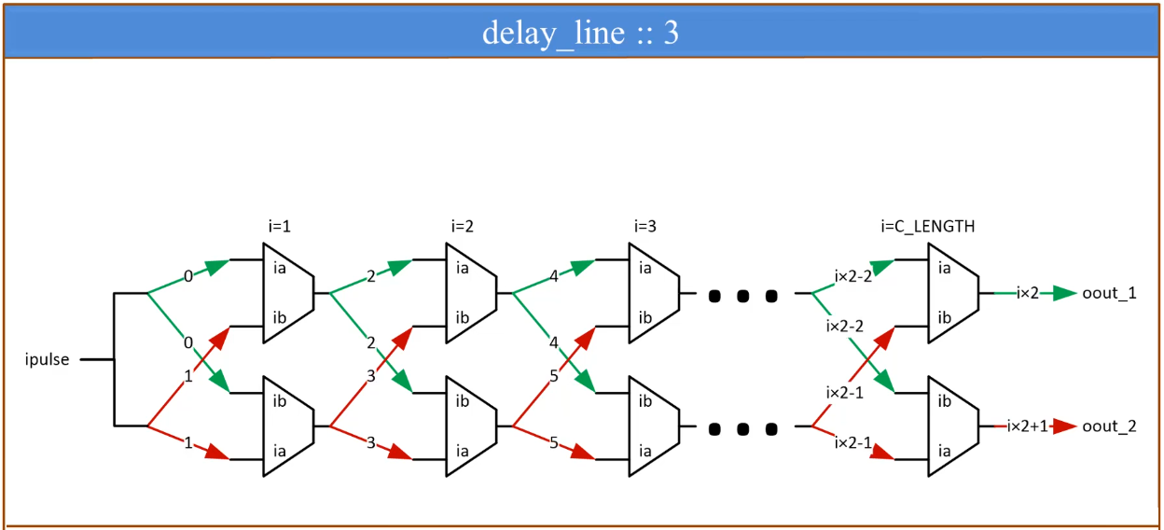

Slide 17
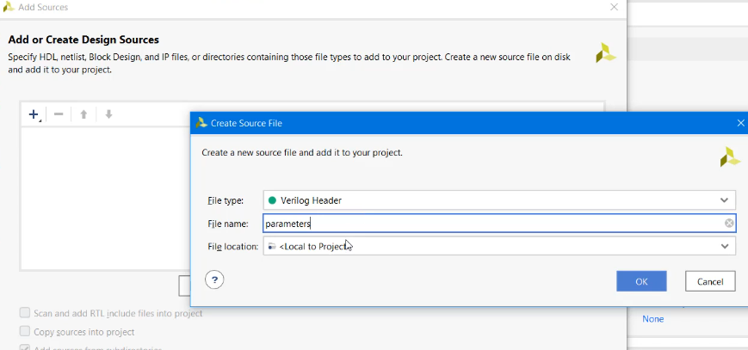
Let’s create a parameter file:

Slide 18
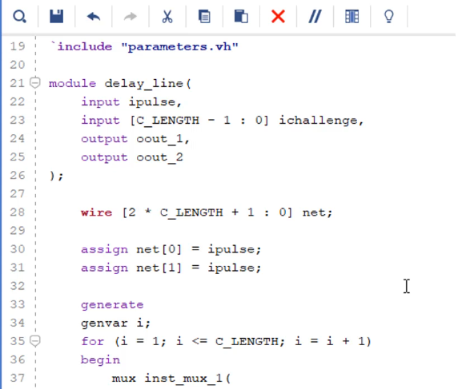
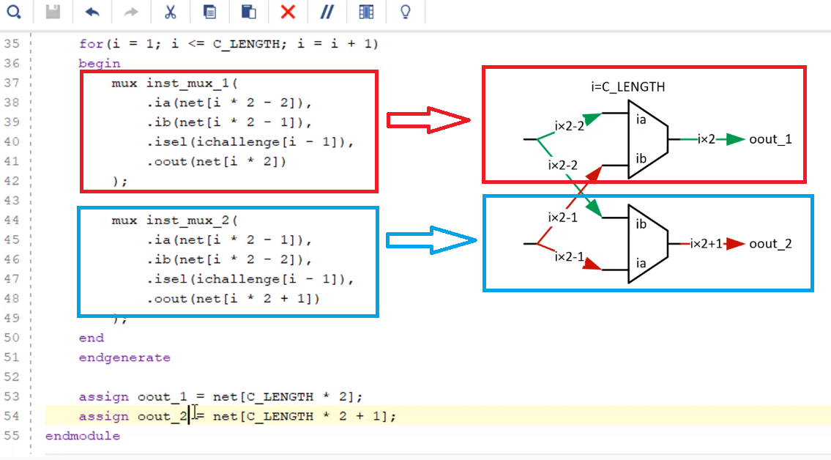
Delay line in verilog (.v):

Slide 19
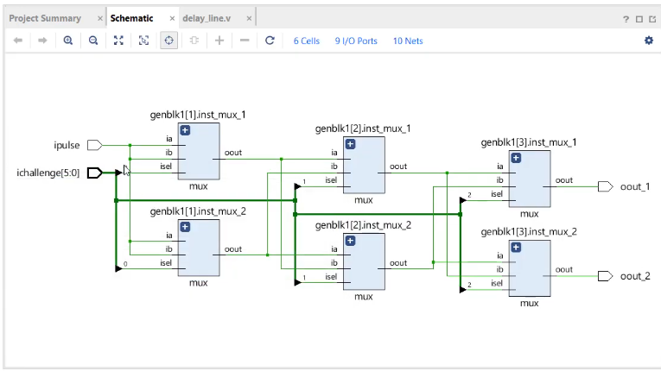
Open Elaborated Design gives us:

Slide 20
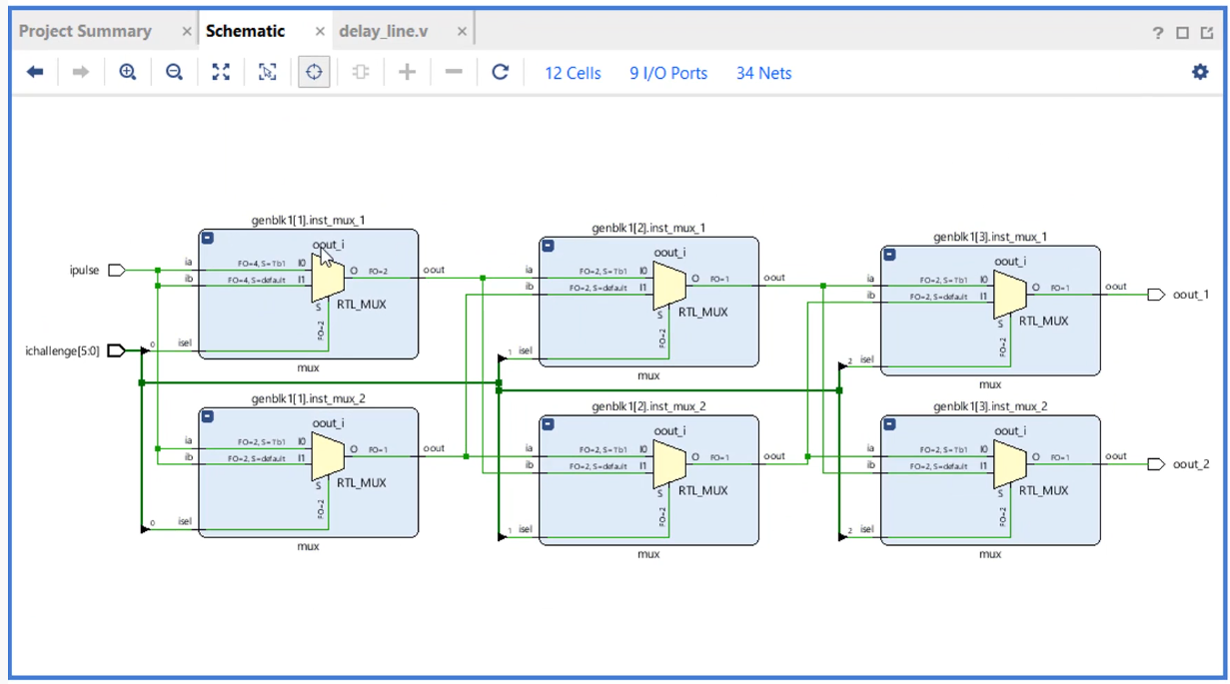
Look from inside confirms we have multiplexers:

Slide 21
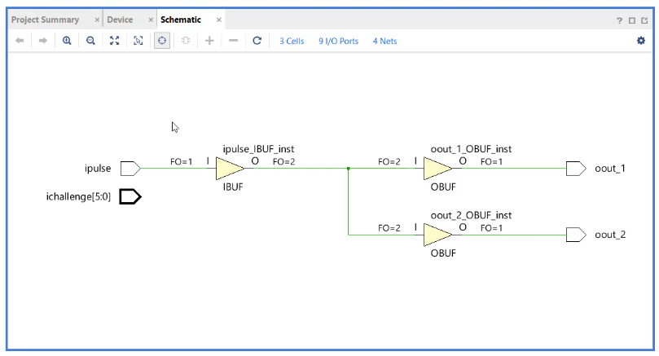
Open Synthesized Design optimized all to zero:

Slide 22
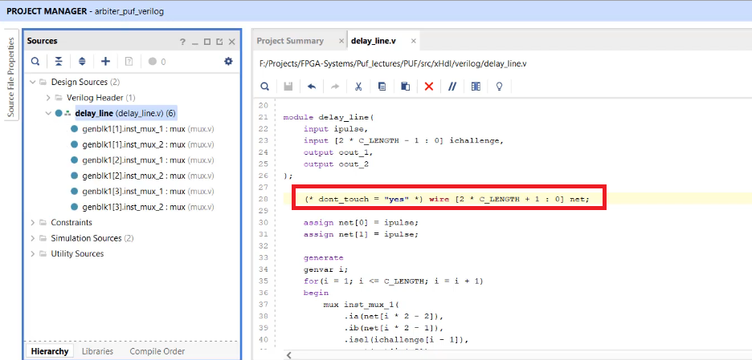
By adding dont_touch we solve this issue:

Slide 23
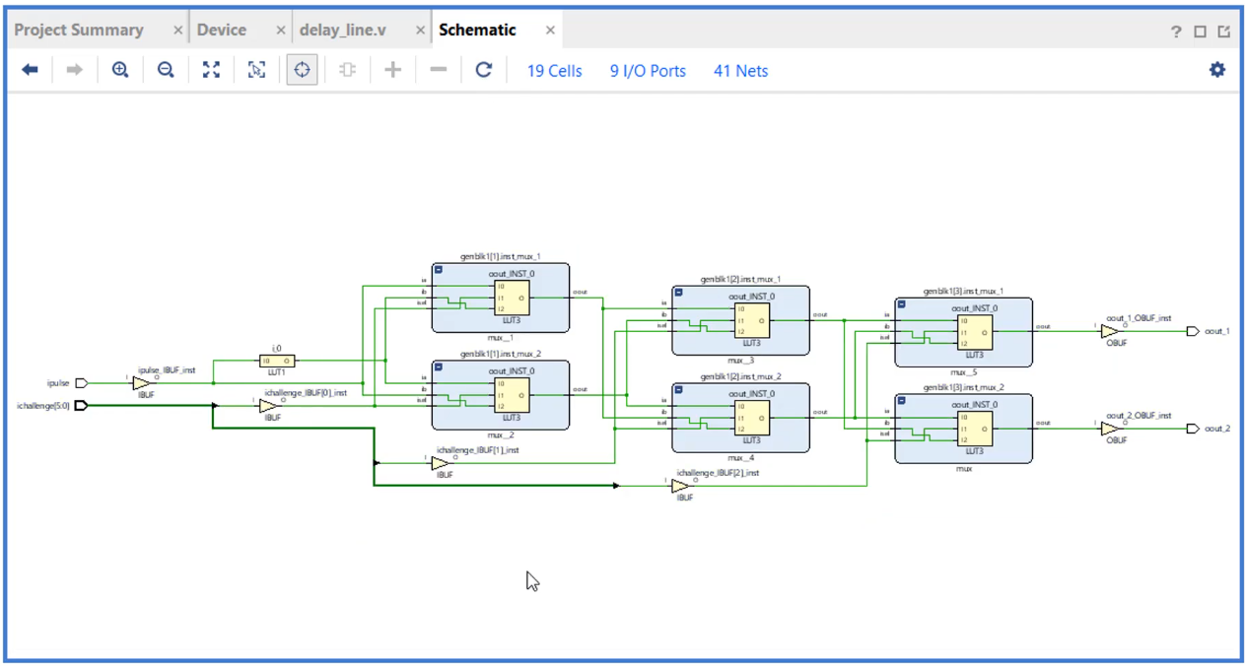
Run synthesis looks now:

Slide 24
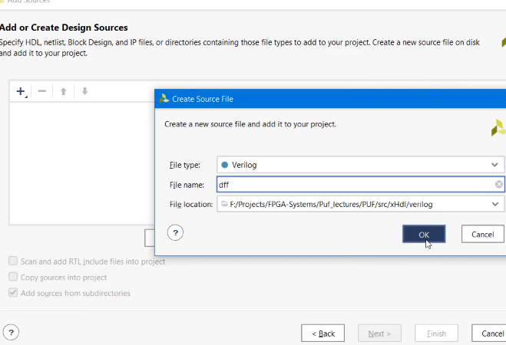
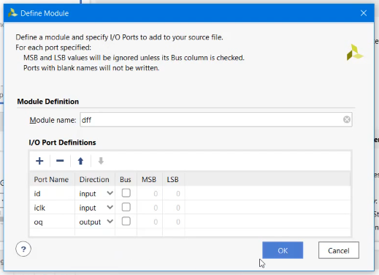
Now, let’s create d-trigger on verilog (.v)

Slide 25
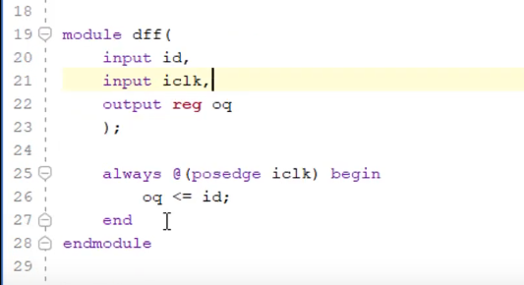
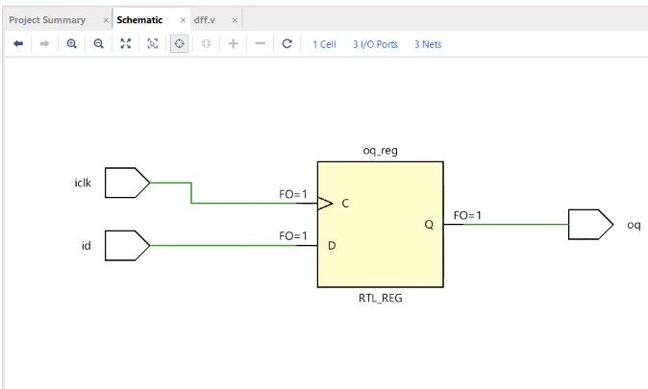
Code for dff + Elaborated Design output:

Slide 26
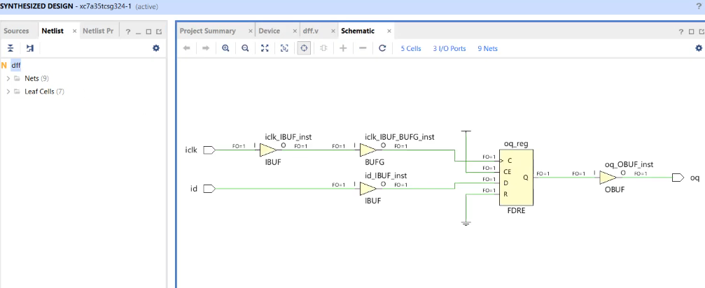
Synthesis shows us that trigger is correct:

Slide 27
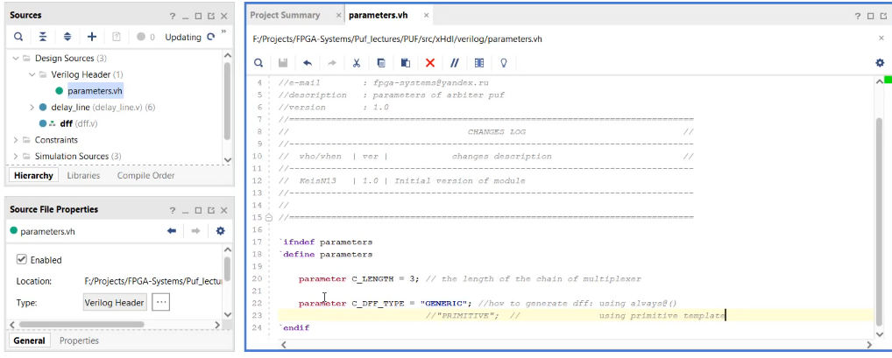
Adding C_DEF_TYPE to parameters

Slide 28
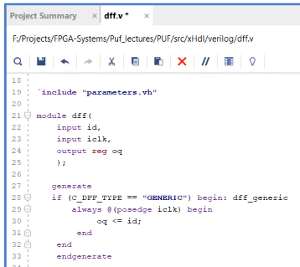
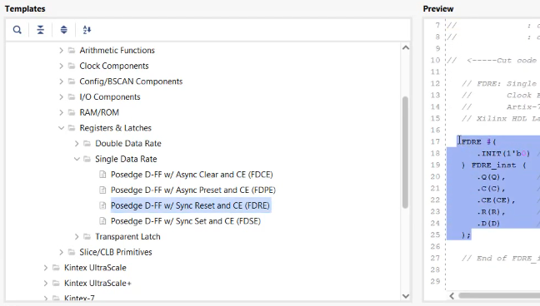
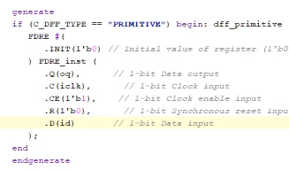
We can modify dff.v

Slide 29
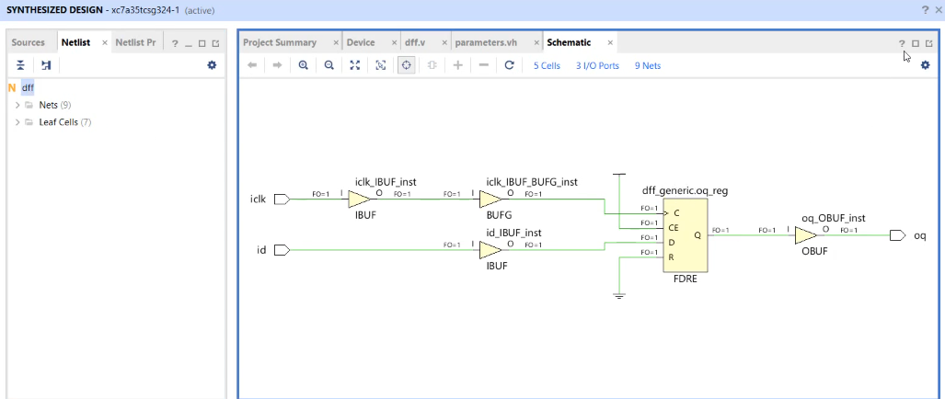
Run Synthesis confirms all was done correctly:

Slide 30
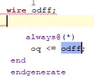
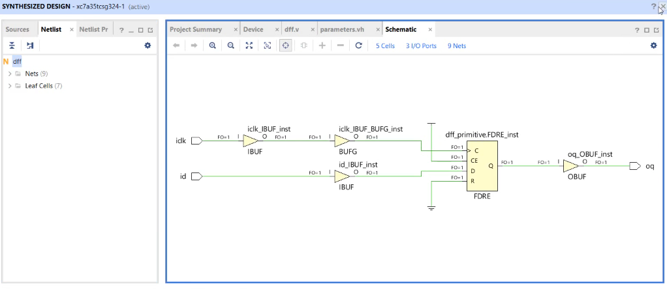
We need to add wire for running as primitive

Slide 31
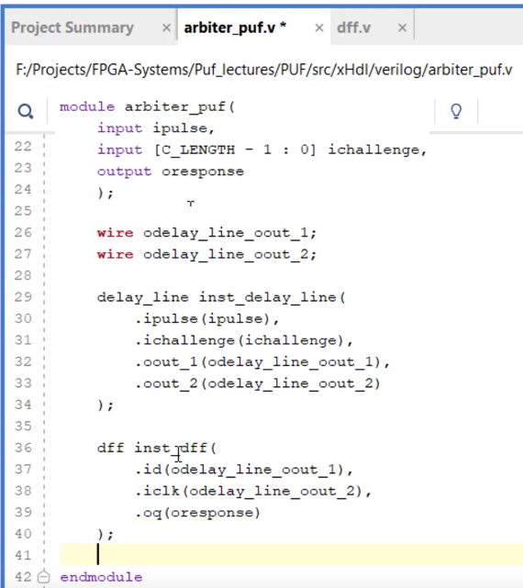
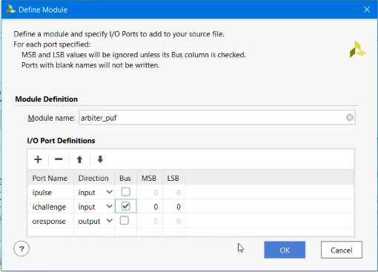
We can collect all in arbiter_puf now:

Slide 32
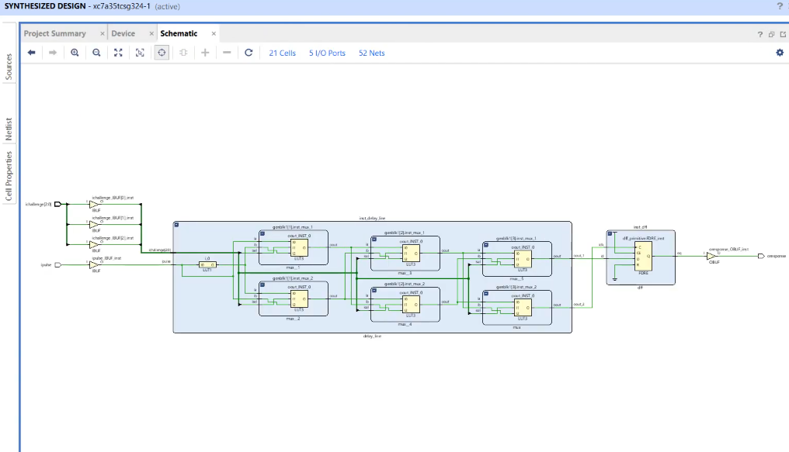
Ready Arbiter PUF:

Slide 33
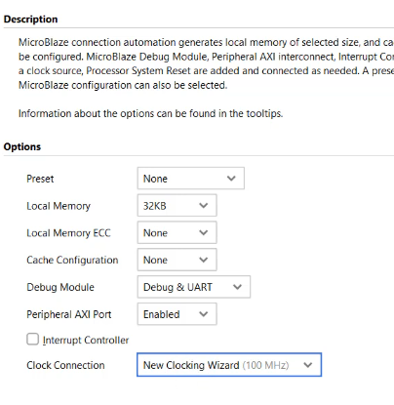
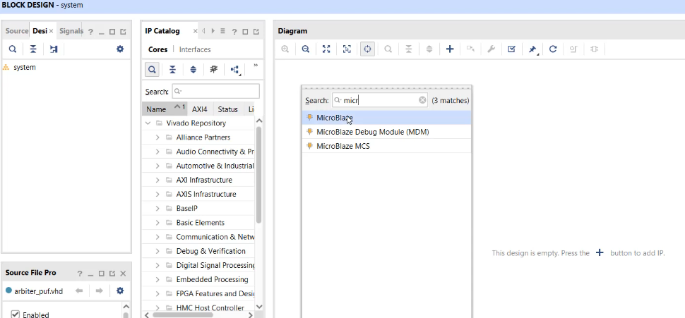
Now we can create Processor System:

Slide 34
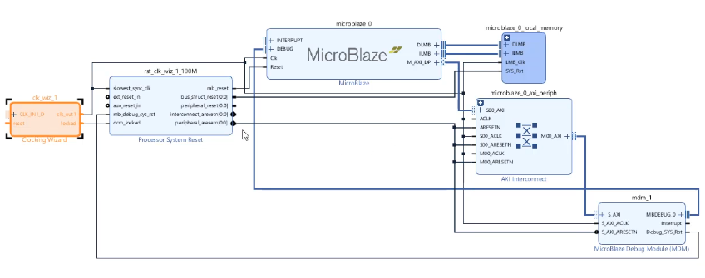

Slide 35
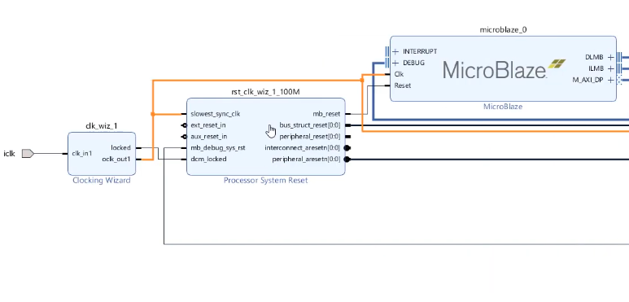
clk_in1 >> external oclk_out1 >> add to the network

Slide 36
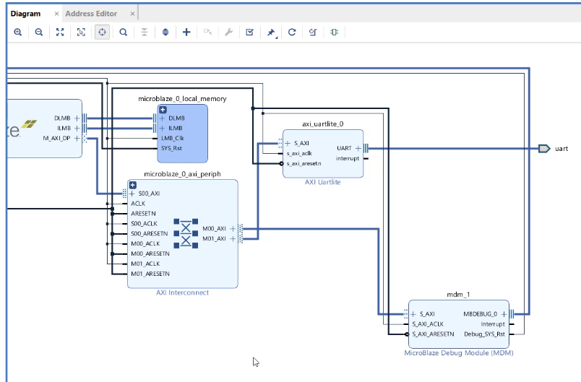
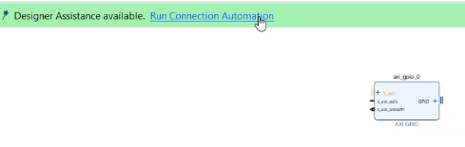
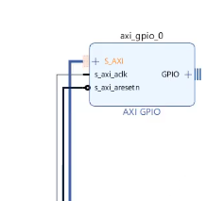
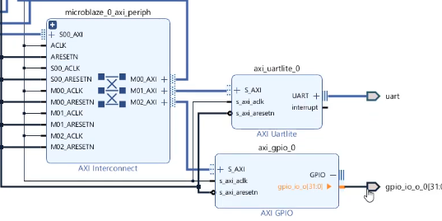
Add modules uartlite and two gpio, run connection automation for correct connection with microblaze

Slide 37
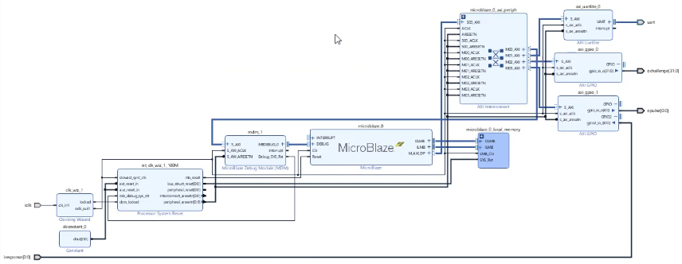
Processor System is done:

Slide 38
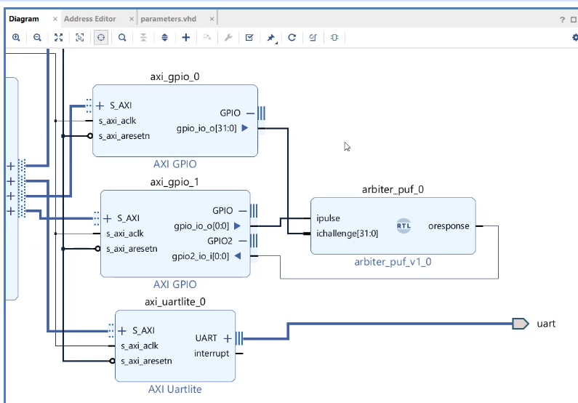
Let’s connect arbiter_puf and microblaze

Slide 39
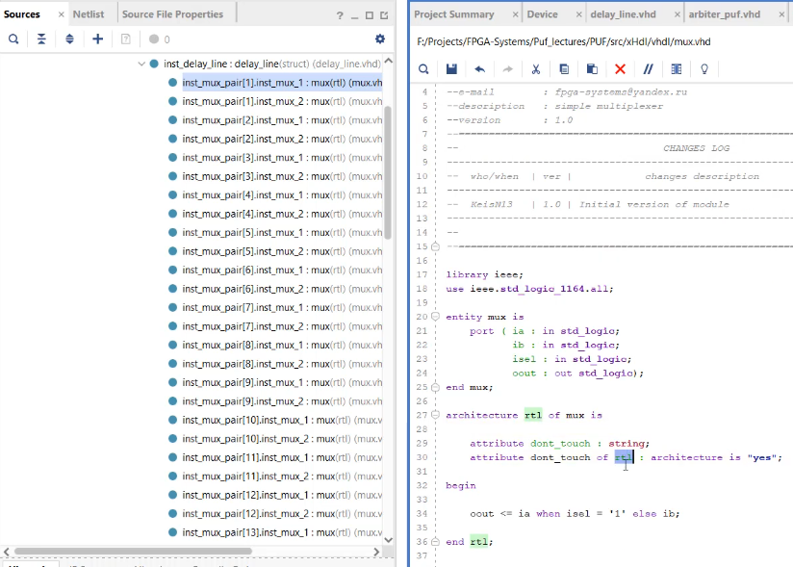
Adding dont_touch to multiplexer module”

Slide 40

Run Synthesis:

Slide 41

Once PUF is done, now let’s create PS

Slide 42

Microblaze creation

Slide 43



Slide 44


Slide 45

Additional module UARTLITE:

Slide 46


Additional module AXI GPIO_0:

Slide 47


Additional module AXI GPIO_1:

Slide 48

Procesor System is done, we need to validate.

Slide 49

We can drag arbiter_puf to integrate it with a PS

Slide 50

Let’s connect our arbiter_puf to GPIO modules

Slide 51

Run Synthesis looks now:

Slide 52


Slide 53


Slide 54


Slide 55


Slide 56




Slide 57


Slide 58


Slide 59

Dividing on blockes:

Slide 60

We need to place all our multiplacers on crystal, we can do it manually one by one:

Slide 61

We have 32 multiplexers pairs + dff,so it’d be better to add it by tcl. Code for it:

Slide 62

After tcl code is doe we have:

Slide 63

Run Implementation looks now:

Slide 64

Our code was successful:

Slide 65

We need additional structure for check:

Slide 66


Slide 67

With the help of added modules we’ll monitor impulses

Slide 68

Now we have additional module for debugging:

Slide 69

How to debug:

Slide 70


Slide 71


Slide 72


Slide 73


Slide 74



Slide 75


Slide 76


Slide 77


Slide 78


Slide 79


Slide 80


Slide 81


Slide 82


Slide 83


Slide 84


Slide 85


Slide 86

Now, we can show results in SDK Terminal:

Slide 87

All responses cannot be cloned as it is all physical unclonable function

Slide 88



Slide 89


